Slide 1

03 - ITD NA Infrastructure and Workplace

Slide 2
ITD North America – Infrastructure & End User Services
End-user computing and workplace support across North America, ensuring reliable day-to-day operations and user productivity.
Corporate mobility services managing an ~850-device fleet with standardized governance, compliance, and cost control across North America.
End User Services
Mobility
Infrastructure Services
Cyber / LISO
Network, datacenter, and core infrastructure services ensuring secure connectivity, system stability, and operational resilience.
PLACE HOLDER
Cybersecurity and LISO oversight providing risk management, OT security governance, and protection of critical infrastructure and operations.
Notes:
Please add LISO/CYBER responsibility to the chart, it is a key area and it needs to be highlighted

Slide 3
IT&D North America – Infrastructure & End User Services
ITD Infra and End User Services / LISO
Enrique Resina
Cyber / LISO
Infrastructure Services
End User Services
Juan Diaz | IT Deskside support Lead
Henry Mclaughlin | GBC Deskside support
Chris White | (E&P – MBU) Deskside support
Travis McGee | (E&P – EFBU) Deskside support
Sierra Khosla | (HOU) Mobility Admin & Deskside support
Miguel Ramirez | (HOU) Deskside Support
Roberto Zepeda | (HOU) Deskside support
Anthony Agostini | (HOU) Deskside support
Infra. & Security Analyst
Infra. & Network Engineer
Infra. & Security Analyst
Reinaldo Figueroa
Wahib Bohsain
Reinaldo Figueroa
© Repsol, SA (Madrid, 2025). All rights reserved.

Slide 4
IT&D North America – Infrastructure & End User Services
Enrique Resina
Cyber / LISO
Reinaldo Figueroa
Infrastructure Services
Reinaldo Figueroa
Wahib Bohsain
End User Services
Juan Diaz
Sierra Khosla
Henry Mclauglin (LCG)
Chris White (MBU)
Travis McGee (EFBU)
Miguel Ramirez
Roberto Zepeda
Anthony Agostini
Infrastructure Services
Wahib Bohsaim | Infrastructure & Network Engineer
Reinaldo Figueroa | Infrastructure & Security Analyst
End User Services
Juan Diaz (RF) | Coordinator & escalation lead
Henry Mclaughlin (DT) | LCG Support
Chris White (MBU) | MBU support
Travis McGee (EFBU) | EFBU support
Sierra Stone (RF) | Deskside support / Mobility Administrator
Roberto Zepeda (RF) | Deskside support
Miguel Ramirez (RF) | Deskside support
Anthony Agostini (RF) | Deskside support
Please add LISO/CYBER as part of the area services
© Repsol, SA (Madrid, 2025). All rights reserved.

Slide 5

IT&D North America – Services & Footprint Summary
People & Users | Assets | Infra. & Budget
1102 Users | 982 Computers | 100 Servers
7 Technicians | 848 Cell Lines | 28 Comm Links
16 Locations | 344 Network Devices | 19 Vendors
6 Data Centers | 36 Conference Rooms | $1.5M Budget
Alaska (17)
Calgary (20)
Regional Footprint
MBU | Horseheads | Pittsburgh |  | Troy
Alaska | Anchorage
Houston | Research Forest | Downtown Office |  | Databank
CNF | Chicago |  | Miami
EFBU | Three Rivers Runge |  | Bluhm Kolo
 | 99 CDP |  | Y-Bar Power Yards
CNF - Chicago
MBU (255)
EFBU (166)
CNF - Miami
Houston (323)

Slide 6
IT&D North America - Overview
Infrastructure & End User Services - 2025
Service Metrics
1,102 Users | 7 Technicians | 16 Locations | 6 Data Centers
982 Computers | 848 Cell Lines | 344 Network Devices | 36 Conference Rooms
100 Servers | 28 Comm Links | 19 Vendors | $1.5M Budget
Alaska (17)
Calgary (20)
EFBU
Three Rivers Runge 99 CDP Bluhm Kolo Y-BAR Power Yards
MBU
Horseheads Pittsburgh Troy
CNF - Chicago
MBU (255)
Alaska
Anchorage
CNF
Chicago Miami
Houston
Research Forest Downtown Office Data Bank
EFBU (166)
CNF - Miami
Houston (323)
Please add a communication map for all USA location, indicating bandwith, carrier, etc.
Notes:
Please add a communication map for all USA location, indicating bandwith, carrier, etc.

Slide 7
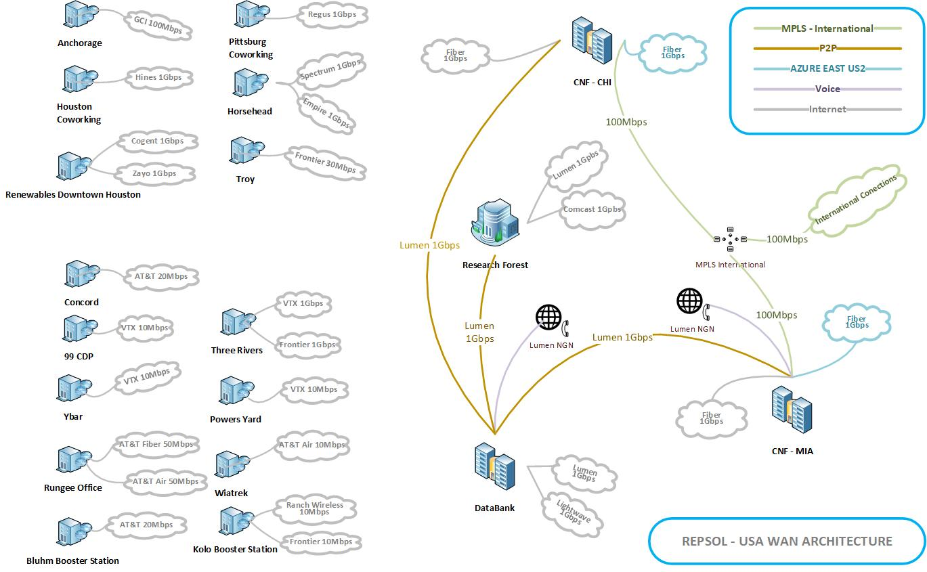
IT&D North America - Communications
Please add a communication map for all USA location, indicating bandwith, carrier, etc.

Slide 8
ITD North America – Deskside Overview
Infrastructure and End User Services 2025
Deskside Closed Tasks by Year
Key Achievements
2024 | 2025 | 2026*
3,534 | 2,884 | 1,056
AT&T Office@Hand
Land: ITD Deskside team migrated existing toll number for land calls to the AT&T Office@Hand service saving 7K in annualized cost to the business.
GBC: ITD Deskside team implemented AT&T Office@Hand for transcribing voicemail calls to email helping the GBC team increase efficiency in response time.
AT&T ITD Proposal (In Progress)
Overhaul of mobile telephony service provider to AT&T as proposal provides ~70K in cost savings and streamlines administration of 724 lines.
Upgrading current mobile device to new Samsung S26 model
Cisco Migration to Cloud
IT Deskside team coordinated and collaborated with Infrastructure and Networking teams in helping the standardization of fixed telephony. Horseheads
GTNA Standardization of Workplace:
Aligned with Repsol standardize workplace for Trading platforms used in Madrid
Townhall / Event Documentation & Communication
Clear documentation of IT’s responsibilities during townhalls. Communication and training with key stakeholders including General Services, PyO, and Administrative Assistants.
Projects:
RENOVA:
Consolidation of storage and IT equipment, recycling of 311 old equipment, and support with workplace user move.
PAE 2026
Successful purchase of 47 workstations
*2026 Completed tasks – by location
Other locations include Calgary, Chicago, and others
Location | Tasks
Research Forest | 586
Horseheads | 154
DownTown Houston | 200
Three Rivers | 62
Runge | 11
Alaska | 13
Other | 30
*Number of closed tasks Jan 2026 – Jun 2026 (In Progress)
Physical Work Locations

Slide 9
IT&D North America – Mobility Overview
Mobility growth driven by onboarding with controlled costs (2024 baseline)
Numbers do not reflect current negotiations with AT&T Proposal
Drivers of Mobility Line Growth (2025)
Increased onboarding across IT&D supported teams
ConnectGen acquisition: 43 lines migrated to Repsol Verizon Account
Mobility assignments based on job function and operational needs
2024 Snapshot (Baseline)
Total Lines: 630
Total Costs $427,529
2025 Snapshot (YTD)
Total Lines: 712
Total Costs: $435,343
2024 represents the baseline year for mobility line and cost comparison.
Notes:
Please add a reason for the mobility line incremental, it was for increase in onboarding? D&C campaign? What was the root cause?
Please add a reference number for past years, like 2024 to have a baseline for comparison purposes

Slide 10
AT&T ITD Proposal
Overhaul of mobile telephony service provider to AT&T as proposal provides ~70K in cost savings and streamlines administration of 724 lines. Upgrading current mobile device to new Samsung S26 model
Category | Current | AT&T | Verizon / Stratix
Scope | 724 | 724 | 800*
Monthly Spend | ~$27.5K | ~$21.6K | ~$29.0K
All-In Rate | — | ~$29.84 | $36.29
Term | Current | 24 months | 36 months
Annual Impact | — | ~$70K savings | Higher than validated AT&T model
Validation Completed
724
Carrier invoices reviewed
Taxes & fees included
Active line counts confirmed
AT&T all-in pricing confirmed — ~$29.84
Post-term pricing confirmed — ~$32.89
Lines Migration Scope
T-Mobile + Verizon only*
Contract Assumptions
Credits included during 24-month term
Credits reflected in proposed all-in pricing
Final credits depend on migration volume and upgrade timing
International: 7 Day Pass days included per billing cycle | $12/day after | International feature validated in writing
Based on current recurring spend and confirmed pricing, AT&T remains the strongest validated financial option for the 724-line migration scope.
*Existing 137 AT&T lines excluded from savings model.
Verizon assumptions are still pending normalization to our 724-line migration scope.

Slide 11
ITD North America
ITD Infrastructure / LISO 2025 Overview
Projects:
LCG New Office: Installed OT network security and connectivity, including routers, the firewall, and network switches.
LCG Control Center: Built the imaging network and deployed core hardware and high-performance workstations.
Alaska Regional Office: Contributed directly to IT infrastructure planning and procurement to support the office launch.
Research Forest Relocation: Planned and completed Phase 1 of IT hardware removal and relocation; currently planning Phase 2 for remaining equipment removal and resource relocation.
Databank Optimization: Removed old equipment and consolidated racks to improve efficiency and space usage.
RenTech Network Refresh: Replaced and upgraded network equipment across the 8th-floors research areas. Upgrade Databank Firewalls.
ROCC & Market Room: Integrated specialized imaging devices to ensure rooms were operational and ready.
Sygnia Security Initiatives: Led weekly implementation meetings with service providers and completed a large amount cybersecurity recommendations.
Key Achievements:
Office Deployments: Led the complete IT infrastructure setup for LCG offices.
Infrastructure Improvements: Continued removing legacy hardware from past years for the Databank closure. The remaining hardware is pending planning and removal.
Network Upgrades: Completed an 8-floor hardware refresh. Added a second WAN link in Three Rivers, and implemented bandwidth-on-demand at Databank and Research Forest.
Control Center Deployment: Delivered the Renewables Control Center installation.
Specialized Technology: Managed the installation of imaging systems for the ROCC and Market Rooms.
Security Leadership: Coordinated and tracked OT security remediation with vendors through weekly working sessions to ensure Sygnia recommendations are implemented for MBU and EFBU. This work is ongoing and will continue this year.

Slide 12
IT&D NA Roadmap – 2026 Initiatives / Roadmap
Jan | Feb | Mar | Apr | May | Jun | Jul | Aug | Sep | Oct | Nov | Dec
GBC Office
Research Forest (End User Services & Infrastructure)
CNF Program
New Alaska Office
ConnectGen Office Decommission
Databank Resizing
WebCalling – Call Manager Migration (Cloud)
PAE Projects
LCG Operations Transition
LCG New Plant
Sygnia Recommendations (MBU / EFBU)
Troy Office
LNG Plants Communication Improvements
Cellphone Renovation (Move to Lease)
ROCC Backup Control Center
Secondary Control Center
Notes:
Please complete the project roadmap with the list of projects w e have in the portfolio and add any other
LISO/CYBER project we are supporting or we will be supporting this year

